Slide 1

Chapter 2 ~ Mathematical Tools in Digital Image Processing
Heaven’s Light is Our Guide
Department of Computer Science & Engineering
Rajshahi University of Engineering & Technology, Rajshahi-6204, Bangladesh.
S. M. Mahedy Hasan
Assistant Professor, Dept. of CSE
RUET, Rajshahi-6204, Bangladesh.

Slide 2
Array versus Matrix Operation
Images can be viewed as array of pixels.
An array operation involves one or more images is carried out on a pixel by pixel basis.
Images can also be viewed equivalently as matrices.
There are many situations in which operations between images are carried out using matrix theory.
Notes:
Help Link: http://users.wfu.edu/matthews/misc/DigPhotog/alias/

Slide 3
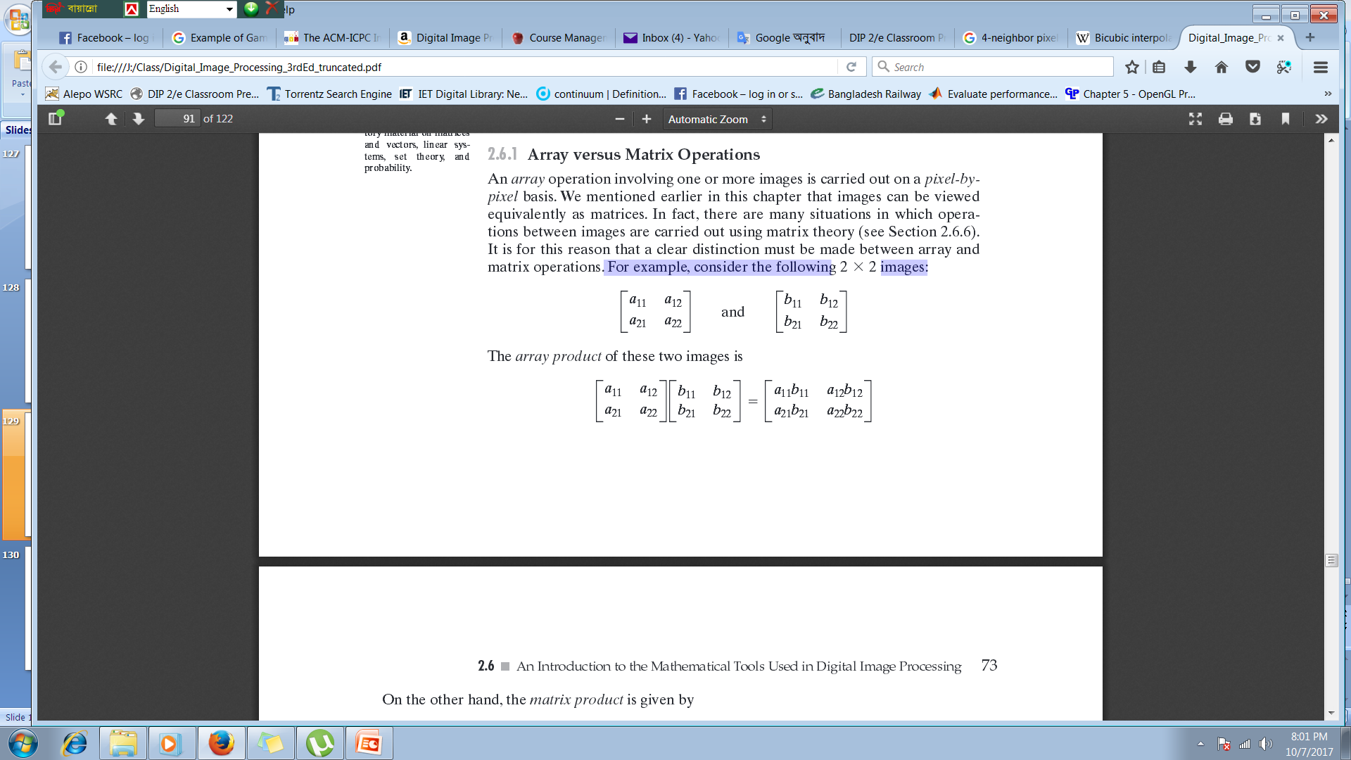
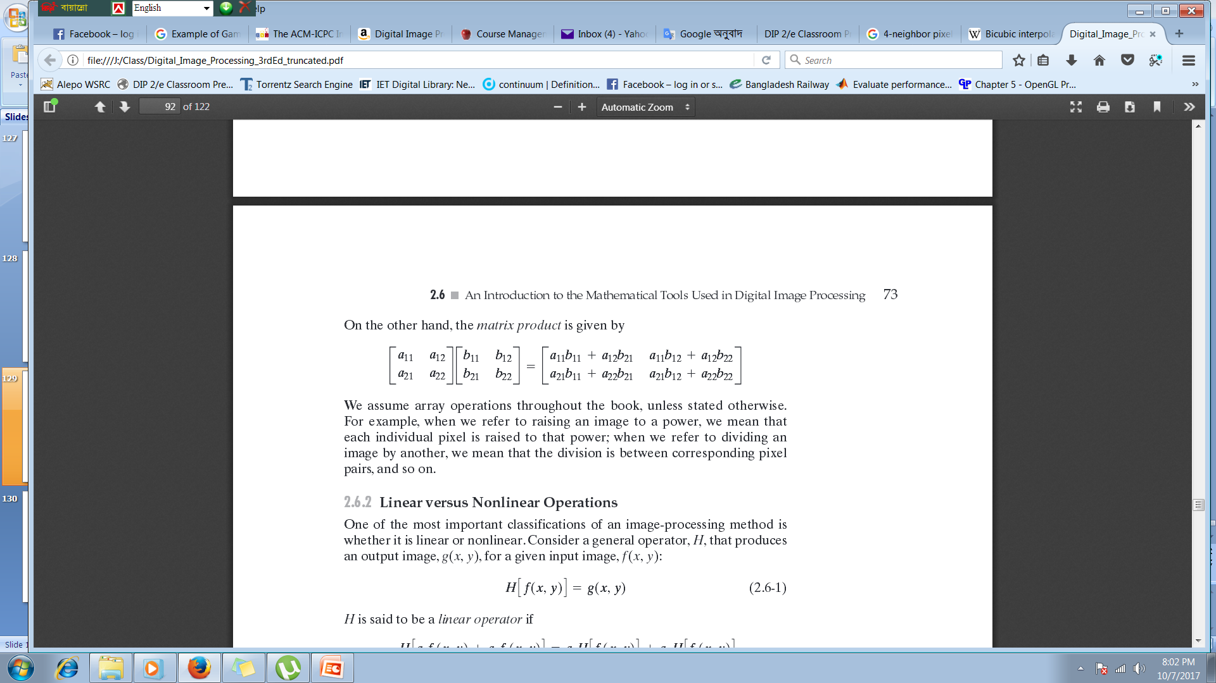
Array versus Matrix Operation
- For example, consider the following 2x2 images:
Notes:
Help Link: http://users.wfu.edu/matthews/misc/DigPhotog/alias/

Slide 4
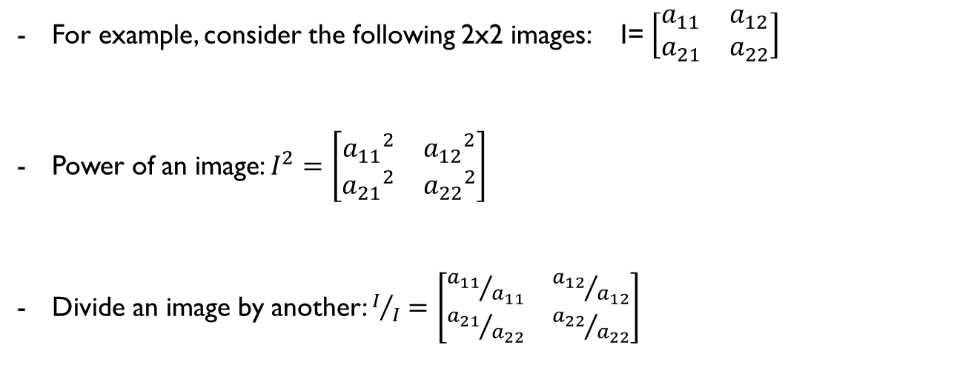
Array versus Matrix Operation
We assume array operations throughout the course:
For example,
When we refer to raising an image to a power, we mean that each individual pixel is raised to that power;
When we refer to dividing an image by another, we mean that the division is between corresponding pixel pairs, and so on.
Notes:
Help Link: http://users.wfu.edu/matthews/misc/DigPhotog/alias/

Slide 5
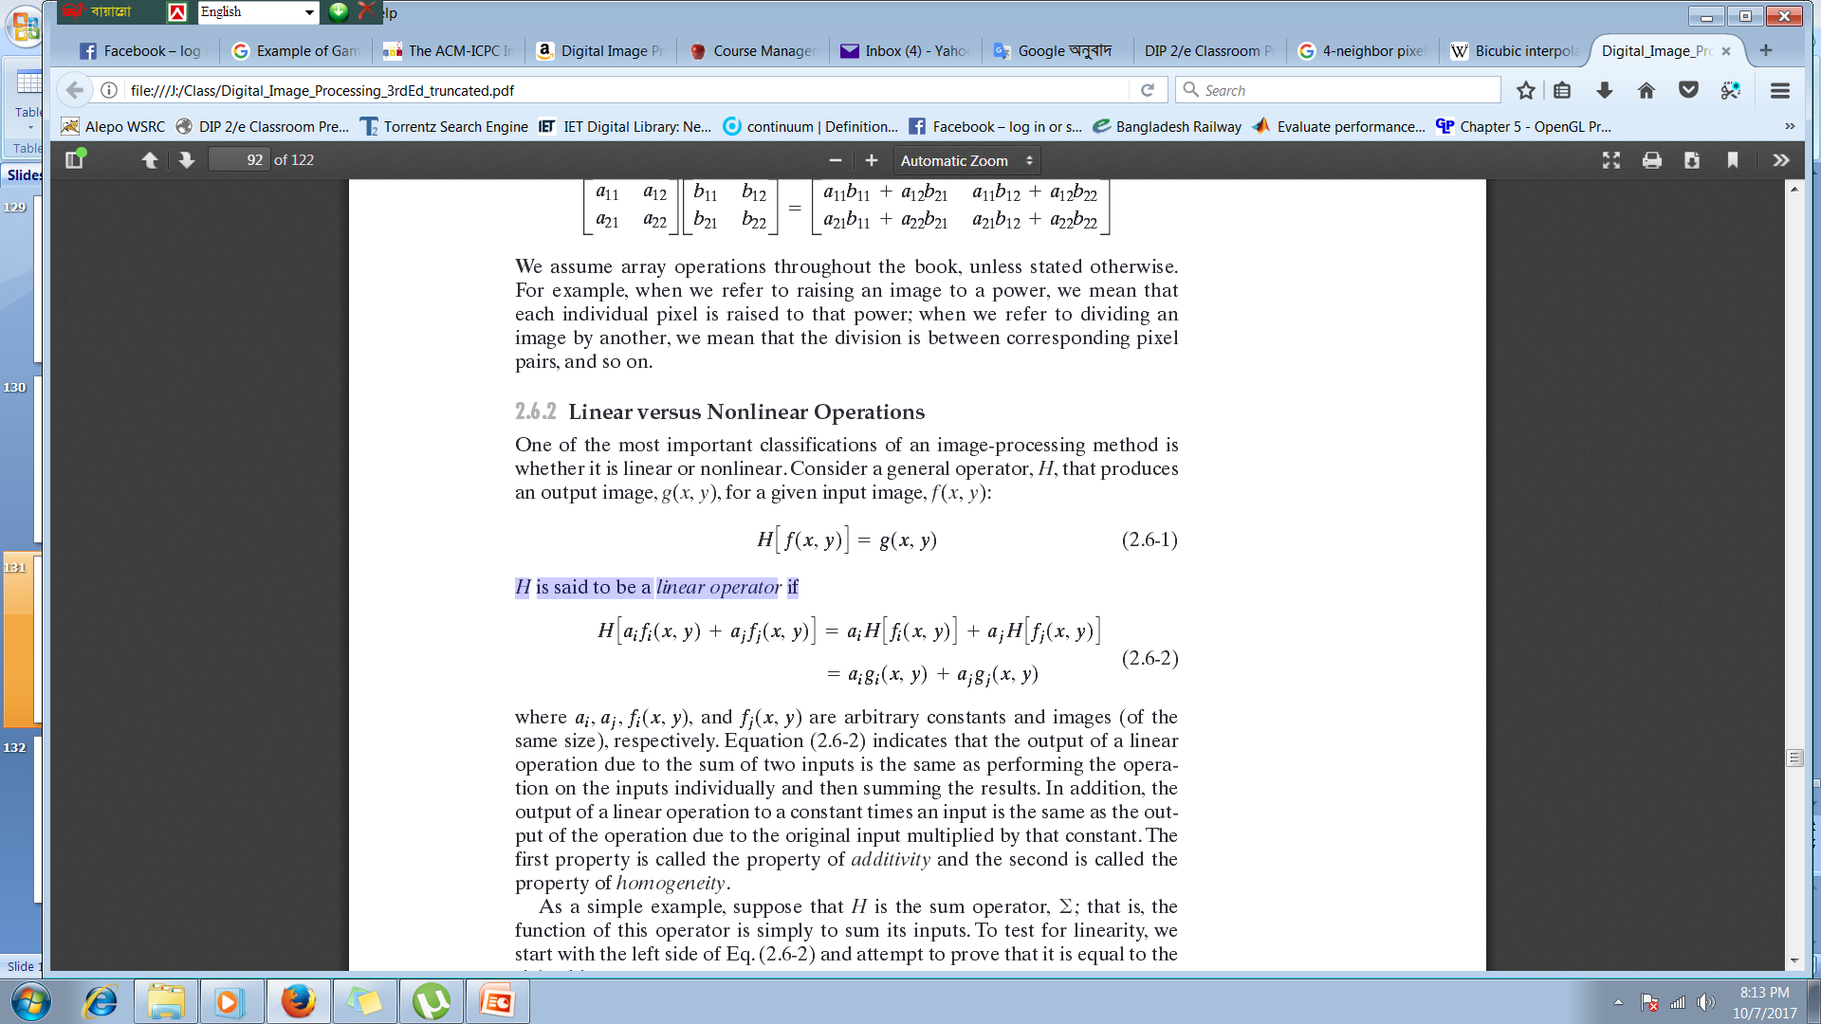
Linear versus Nonlinear Operation
Consider a general operator, H, that produces an output image, g(x,y), for a given input image, f(x,y):
H is said to be a linear operator if,
Where, a_{i} and a_{j} are arbitrary constant and f_{i}(x, y) and f_{j}(x, y) are two images of same sizes.
Notes:
Help Link: http://users.wfu.edu/matthews/misc/DigPhotog/alias/

Slide 6
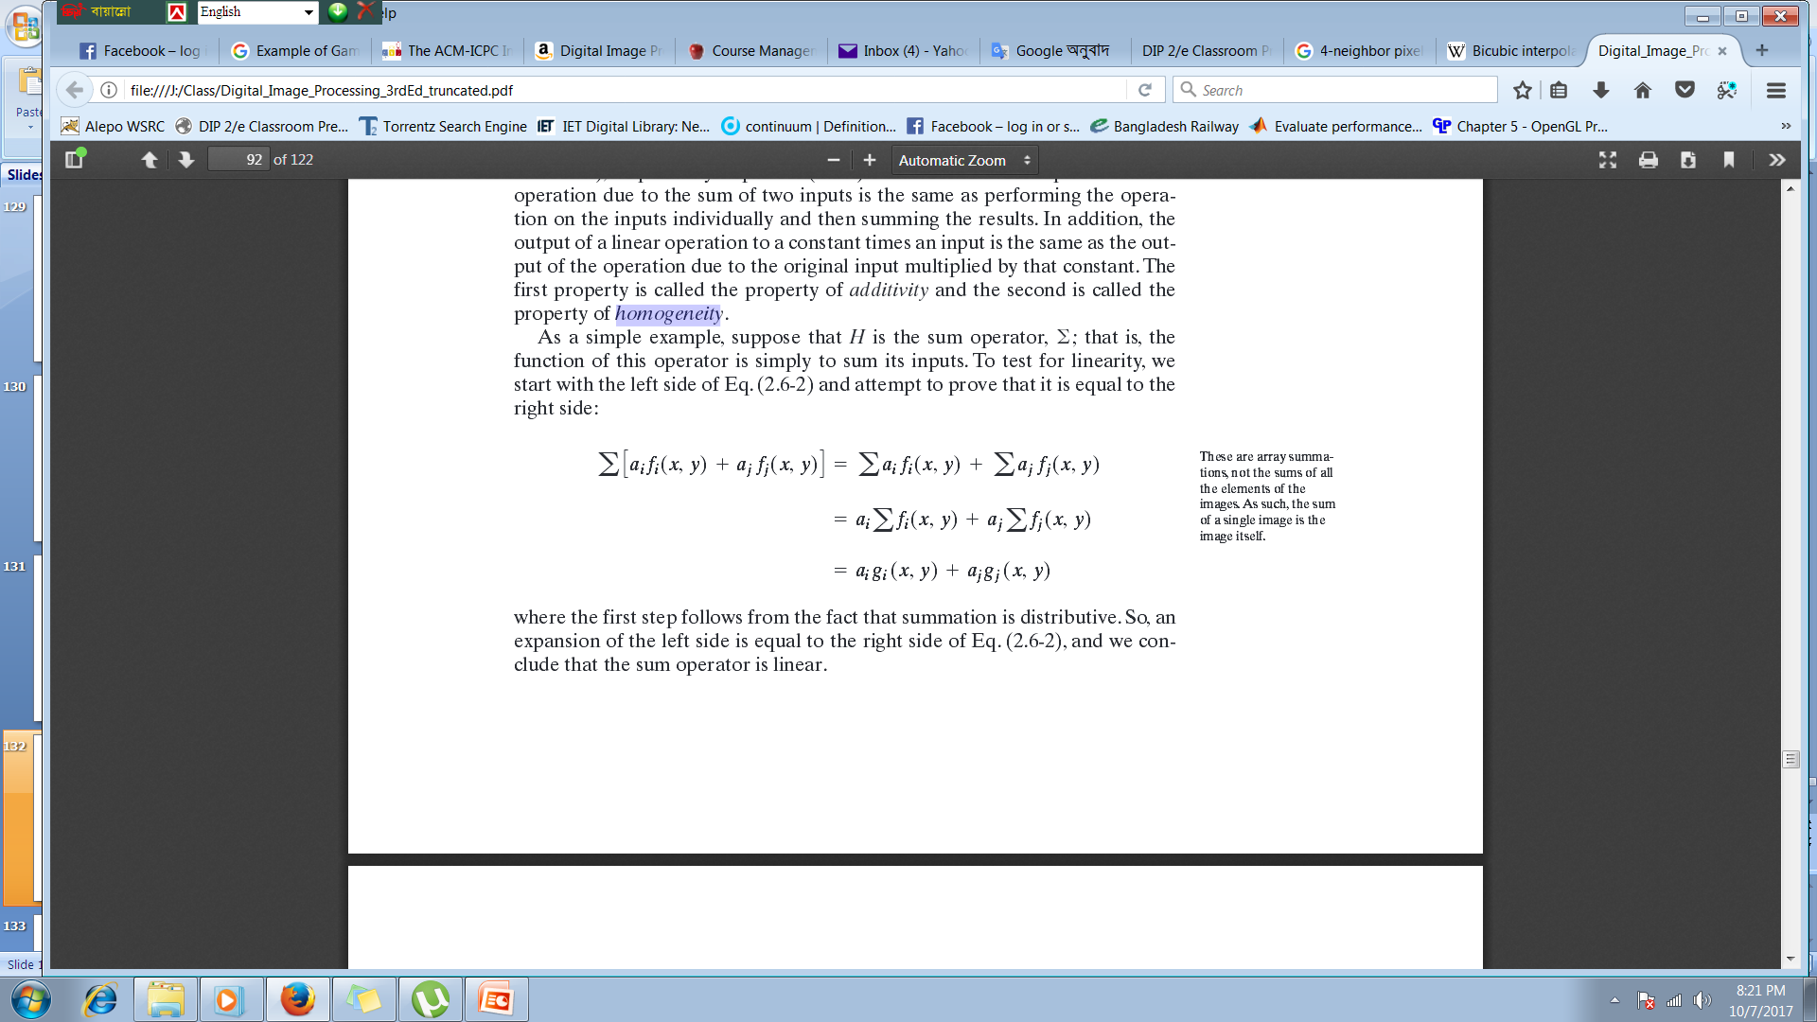
Linear versus Nonlinear Operation
Let’s consider the general operator ‘H’ as a summation operator ‘$\text{Σ}$’
Notes:
Help Link: http://users.wfu.edu/matthews/misc/DigPhotog/alias/

Slide 7
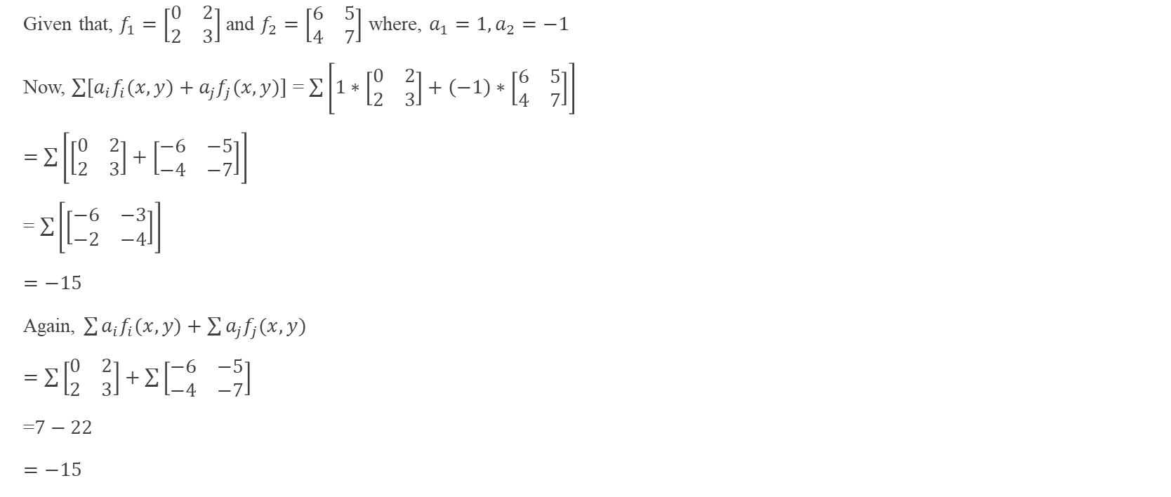
Linear versus Nonlinear Operation
Given that, $f_{1}=\left[\begin{matrix}0 & 2 \\ 2 & 3\end{matrix}\right]$and $f_{2}=\left[\begin{matrix}6 & 5 \\ 4 & 7\end{matrix}\right]$ where, $a_{1}=1, a_{2}=−1$
Now, $\sum{[a_{i}f_{i}(x, y)}+a_{j}f_{j}(x,y)]$ = $\sum{\left[1∗\left[\begin{matrix}0 & 2 \\ 2 & 3\end{matrix}\right]+\left(−1\right)∗\left[\begin{matrix}6 & 5 \\ 4 & 7\end{matrix}\right]\right]}$
$=$ $\sum{\left[\left[\begin{matrix}0 & 2 \\ 2 & 3\end{matrix}\right]+\left[\begin{matrix}−6 & −5 \\ −4 & −7\end{matrix}\right]\right]}$
= $\sum{\left[\left[\begin{matrix}−6 & −3 \\ −2 & −4\end{matrix}\right]\right]}$
$=−15$
Again, $\sum{a_{i}f_{i}(x, y)}+$ $\sum{a_{j}f_{j}(x, y)}$
$=\sum{\left[\begin{matrix}0 & 2 \\ 2 & 3\end{matrix}\right]+\sum{\left[\begin{matrix}−6 & −5 \\ −4 & −7\end{matrix}\right]}}$
=$7−22$
$=−15$

Slide 8
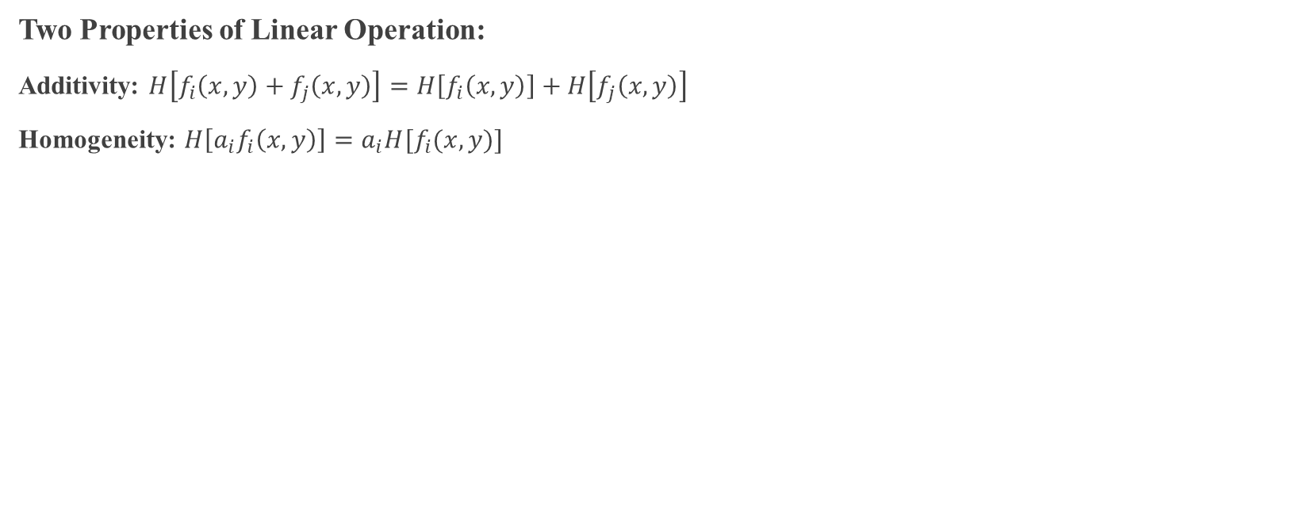
Linear versus Nonlinear Operation
Two Properties of Linear Operation:
Additivity: $H\left[f_{i}\left(x, y\right)+f_{j}\left(x,y\right)\right]=H\left[f_{i}\left(x, y\right)\right]+H\left[f_{j}\left(x,y\right)\right]$
Homogeneity: $H\left[a_{i}f_{i}\left(x,y\right)\right]=a_{i}H[f_{i}(x, y)]$
Equation indicates that the output of a linear equation due to the sum of two inputs is the same as performing the operation on the inputs individually and then summing the results.
In addition, the output of a linear equation to a constant times an input as the same as the output of the operation due to original input multiplied by that constant.
Notes:
Help Link: http://users.wfu.edu/matthews/misc/DigPhotog/alias/

Slide 9
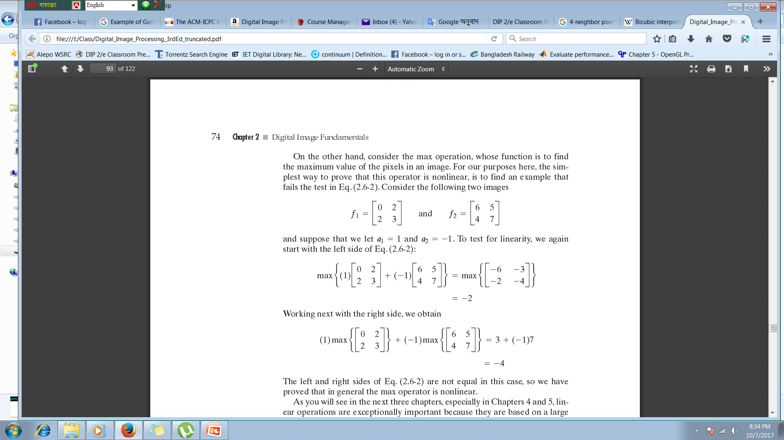
Linear versus Nonlinear Operation
Example: Non-Linear Operation
Consider the max operation, whose function is to find the maximum value of pixels in an image,
Notes:
Help Link: http://users.wfu.edu/matthews/misc/DigPhotog/alias/

Slide 10
Linear versus Nonlinear Operation
Linear operation are exceptionally important, because they are based on a large body of theoretical and practical results that are applicable to image processing.
Non-linear systems are not nearly as well understood, so there scope of application is more limited.
But, there are several non-linear image processing operations whose performance far exceeds what is achievable by their linear counterparts.
Notes:
Help Link: http://users.wfu.edu/matthews/misc/DigPhotog/alias/

Slide 11
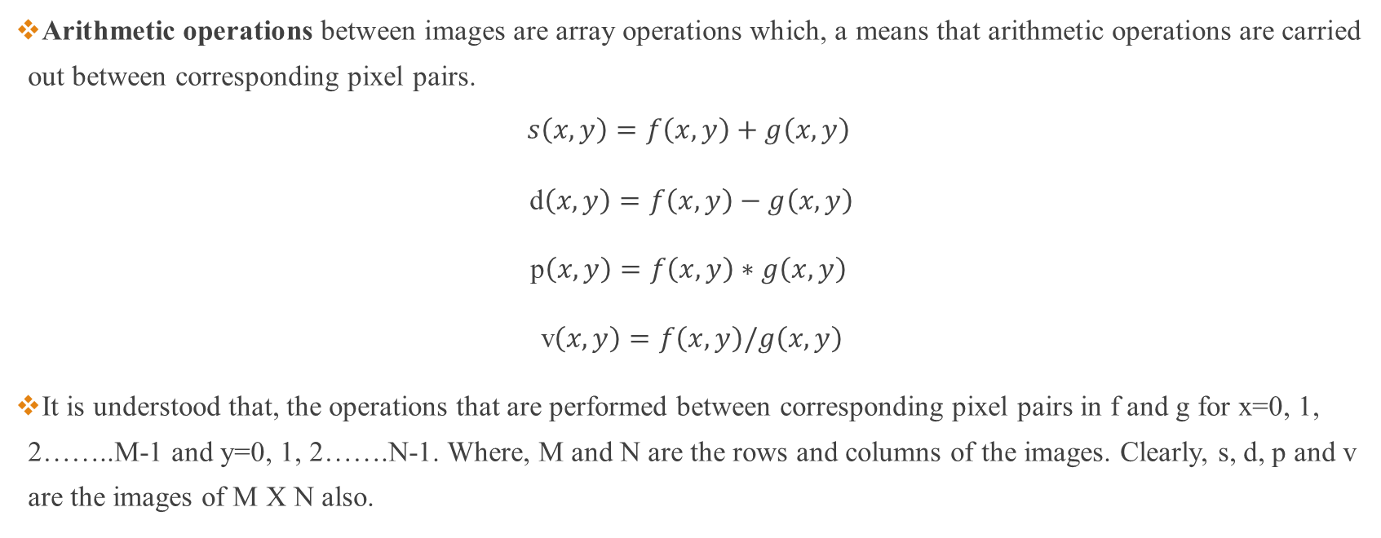
Arithmetic Operations
Arithmetic operations between images are array operations which, a means that arithmetic operations are carried out between corresponding pixel pairs.
$$s\left(x,y\right)=f\left(x,y\right)+g\left(x,y\right)$$
d$\left(x,y\right)=f\left(x,y\right)−g\left(x,y\right)$
p$\left(x,y\right)=f\left(x,y\right)∗g\left(x,y\right)$
v$\left(x,y\right)=f\left(x,y\right)/g\left(x,y\right)$
It is understood that, the operations that are performed between corresponding pixel pairs in f and g for x=0, 1, 2……..M-1 and y=0, 1, 2…….N-1. Where, M and N are the rows and columns of the images. Clearly, s, d, p and v are the images of M X N also.

Slide 12
Arithmetic Operation
Few important considerations:-
If the result is a floating point number, round off it’s value.
If the result is above the pixel range, select the maximum range value.
If the result is below the pixel range, select the minimum range value.
If the result is infinity, write it as zero.

Slide 13
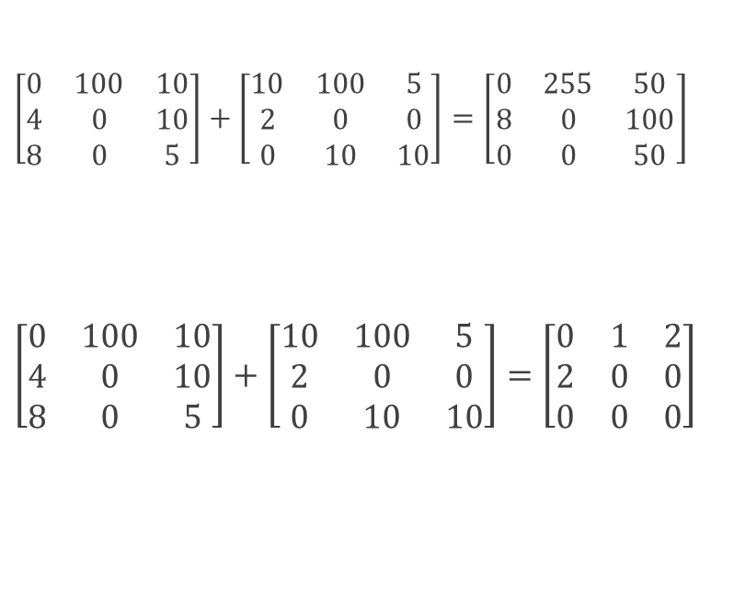
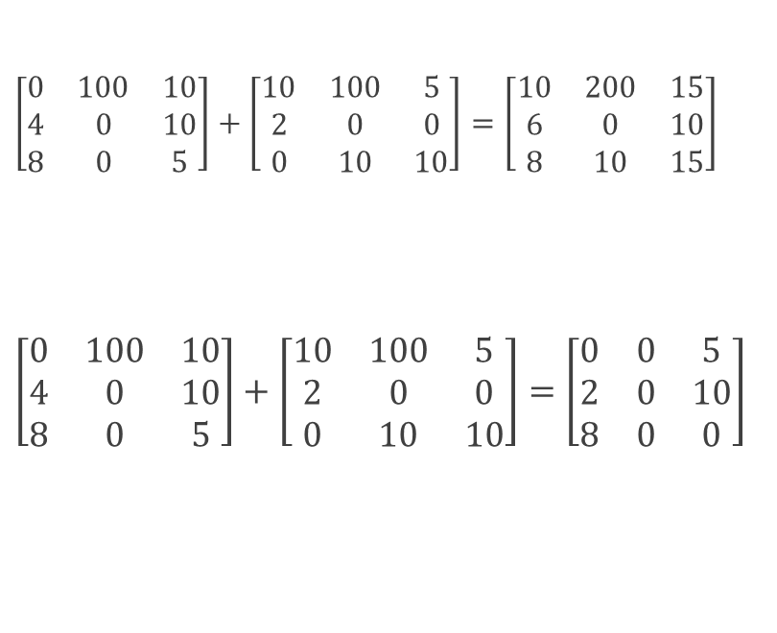
Arithmetic Operation
$\left[\begin{matrix}0 & 100 & 10 \\ 4 & 0 & 10 \\ 8 & 0 & 5\end{matrix}\right]+\left[\begin{matrix}10 & 100 & 5 \\ 2 & 0 & 0 \\ 0 & 10 & 10\end{matrix}\right]=\left[\begin{matrix}10 & 200 & 15 \\ 6 & 0 & 10 \\ 8 & 10 & 15\end{matrix}\right]$
$\left[\begin{matrix}0 & 100 & 10 \\ 4 & 0 & 10 \\ 8 & 0 & 5\end{matrix}\right]+\left[\begin{matrix}10 & 100 & 5 \\ 2 & 0 & 0 \\ 0 & 10 & 10\end{matrix}\right]=\left[\begin{matrix}0 & 0 & 5 \\ 2 & 0 & 10 \\ 8 & 0 & 0\end{matrix}\right]$
A
A
B
$\left[\begin{matrix}0 & 100 & 10 \\ 4 & 0 & 10 \\ 8 & 0 & 5\end{matrix}\right]+\left[\begin{matrix}10 & 100 & 5 \\ 2 & 0 & 0 \\ 0 & 10 & 10\end{matrix}\right]=\left[\begin{matrix}0 & 255 & 50 \\ 8 & 0 & 100 \\ 0 & 0 & 50\end{matrix}\right]$
$\left[\begin{matrix}0 & 100 & 10 \\ 4 & 0 & 10 \\ 8 & 0 & 5\end{matrix}\right]+\left[\begin{matrix}10 & 100 & 5 \\ 2 & 0 & 0 \\ 0 & 10 & 10\end{matrix}\right]=\left[\begin{matrix}0 & 1 & 2 \\ 2 & 0 & 0 \\ 0 & 0 & 0\end{matrix}\right]$
A+B
B
A*B
A
B
A-B
A
B
A/B
Here, all the considered images are of gray level and their intensity value ranges from 0…….255

Slide 14
Arithmetic Operation (Addition)
Example: Addition (averaging) of noisy images for noise reduction.
Used in image enhancement.
Image averaging is used in the field of astronomy.
Let g(x,y) denote a corrupted image formed by the addition of noise, η(x, y) to a noiseless image f(x,y); that is,
The objective of the following procedure is to reduce the noise content of the output image by adding a set of noisy input images, This is a technique used frequently for image enhancement.
Notes:
Help Link: http://users.wfu.edu/matthews/misc/DigPhotog/alias/

Slide 15
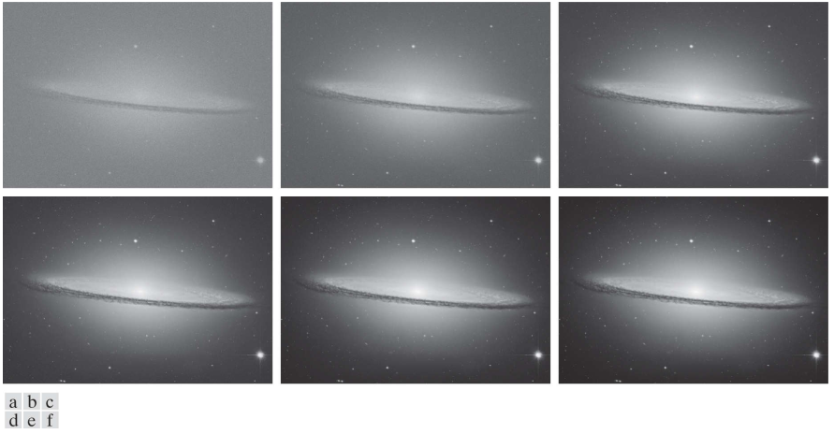
Arithmetic Operation (Addition)
Figure 1: (a) Sample noisy image of the Sombrero Galaxy. (b)-(f) Result of averaging 10, 50, 100, 500, and 1,000 noisy images, respectively. All images are of size pixels, and all were scaled so that their intensities would span the full [0, 255] intensity scale.
Notes:
Help Link: http://users.wfu.edu/matthews/misc/DigPhotog/alias/

Slide 16
Arithmetic Operation
The mean of a sample is
Mean does not tell us a lot about the data except for a sort of middle point.
X = [0 8 12 20]
Mean = 10
Y = [8 9 11 12]
Mean = 10
What is different about two sets?
Notes:
Help Link: http://users.wfu.edu/matthews/misc/DigPhotog/alias/

Slide 17
Arithmetic Operation
The standard deviation of a sample is,
Why are we using n-1 and not n?
Because we take a subset of the real world and this value represents the closer to the standard deviation. If we can take full sample then we can use n instead of n-1.
Notes:
Help Link: http://users.wfu.edu/matthews/misc/DigPhotog/alias/

Slide 18
Arithmetic Operation
What is different about two sets?
X = [0 8 12 20]
Mean – 10
Standard Deviation ~ 8.33
Y = [8 9 11 12]
Mean – 10
Standard Deviation ~ 1.83
Result?
Better
Notes:
Help Link: http://users.wfu.edu/matthews/misc/DigPhotog/alias/

Slide 19
Arithmetic Operation (Subtraction)
A frequent application of image subtraction is in the enhancement of including correcting uneven illuminance and comparing two images.
Mask mode radiography in medical imaging.
Notes:
Help Link: http://users.wfu.edu/matthews/misc/DigPhotog/alias/

Slide 20
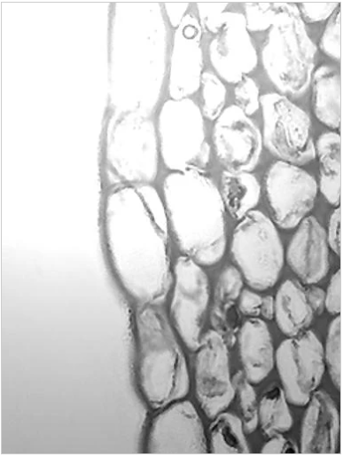

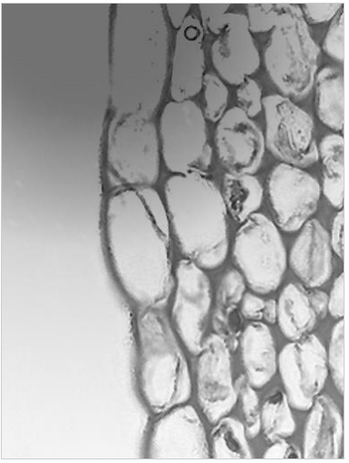
Arithmetic Operation (Subtraction)
Figure 2: (a) Original Image (b) Reference Image (c) Difference of the two images, scaled to the range [0, 255] for clarity.

Slide 21
Arithmetic Operation (Subtraction)
Image subtraction in medical imaging is called mask mode radiography
In this case h(x, y), the mask, is an X-ray image of a region of a patient’s body captured by an intensified TV camera (instead of traditional X-ray film) located opposite an X-ray source.
The procedure consists of injecting an X-ray contrast material into the patient’s bloodstream, taking a series of images called live images, f(x, y), samples of which are denoted as f(x, y)] of the same anatomical region as h(x, y), and subtracting the mask from the series of incoming live images after injection of the contrast material.
The net effect of subtracting the mask from each sample live image is that the areas that are different between f(x, y) and h(x, y) appear in the output image, g(x, y), as enhanced detail.
Notes:
Help Link: http://users.wfu.edu/matthews/misc/DigPhotog/alias/

Slide 22
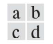
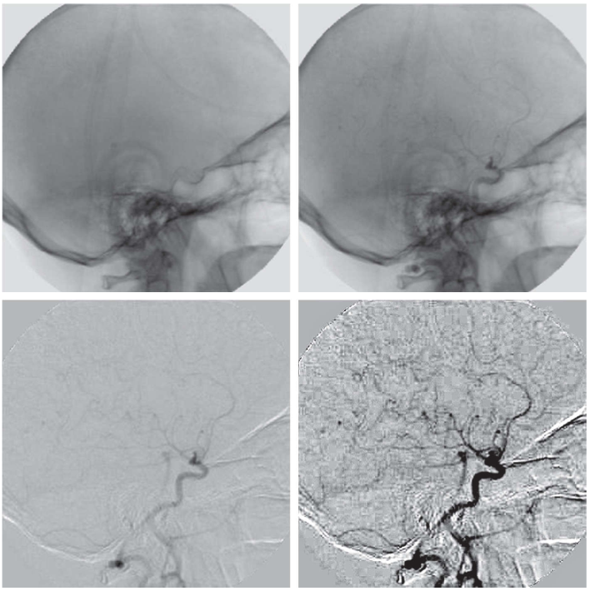
Arithmetic Operation (Subtraction)
Figure 3: Digital subtraction angiography. (a) Mask image. (b) A live image. (c) Difference between (a) and (b). (d) Enhanced difference image.
Notes:
Help Link: http://users.wfu.edu/matthews/misc/DigPhotog/alias/

Slide 23
Arithmetic Operation (Multiplication and Division)
An important application of image multiplication (and division) is shading correction.
Suppose that an imaging sensor produces images, g(x,y),
f(x,y) indicates perfect image
h(x,y) indicates a shading function
Notes:
Help Link: http://users.wfu.edu/matthews/misc/DigPhotog/alias/

Slide 24
Arithmetic Operation (Multiplication and Division)
If h(x, y) is known!!!!
- multiplying the sensed image g(x, y) by the inverse of h(x, y)
Notes:
Help Link: http://users.wfu.edu/matthews/misc/DigPhotog/alias/

Slide 25
Arithmetic Operation (Multiplication and Division)
If h(x,y) is unknown!!!!
We can find out h(x,y)…..
Discuss in chapter 9
Notes:
Help Link: http://users.wfu.edu/matthews/misc/DigPhotog/alias/

Slide 26
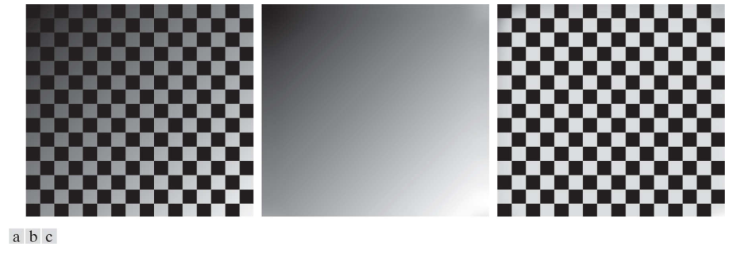
Arithmetic Operation (Multiplication and Division)
Figure 4: Shading correction. (a) Shaded test pattern. (b) Estimated shading pattern. (c) Product of (a) by the reciprocal of (b).
Notes:
Help Link: http://users.wfu.edu/matthews/misc/DigPhotog/alias/

Slide 27
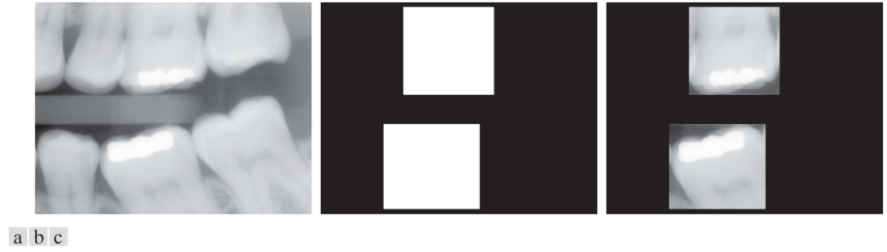
Arithmetic Operation (Multiplication and Division)
Another common use of image multiplication is in masking, also called region of interest (ROI), operations.
Multiplying a given image by a mask image that has 1’s in the ROI and 0’s elsewhere.
Figure 5: (a) Digital dental X-ray image. (b) ROI mask for isolating teeth with fillings (white corresponds to 1 and black corresponds to 0). (c) Product of (a) and (b).
Notes:
Help Link: http://users.wfu.edu/matthews/misc/DigPhotog/alias/

Slide 28
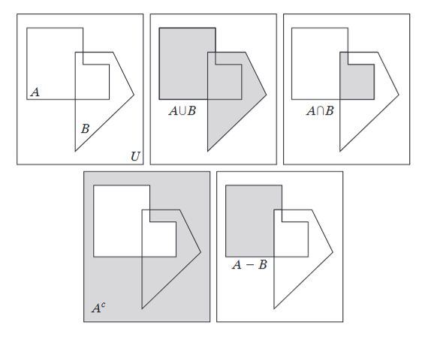
Set Operations
Notes:
Help Link: http://users.wfu.edu/matthews/misc/DigPhotog/alias/

Slide 29
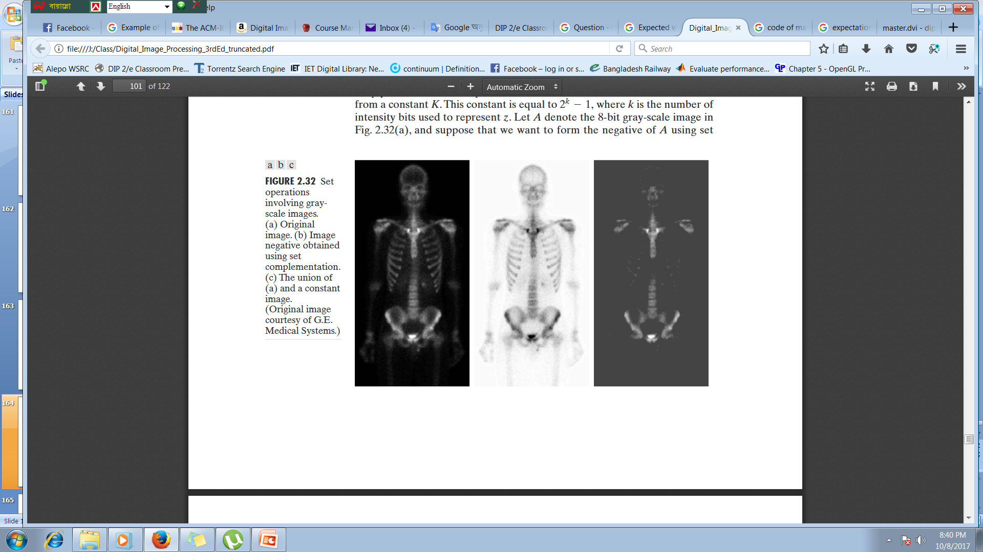
Image Negatives
Set operations involving image intensities.
Let the elements of a grayscale image be represented by a set A whose elements are triplets of the form (x, y, z), where x and y are spatial coordinates, and z denotes intensity values. We define the complement of A as the set,
A =
A^{c} =
Notes:
Help Link: http://users.wfu.edu/matthews/misc/DigPhotog/alias/

Slide 30
Logical Operations
Logical operations deal with TRUE (typically denoted by 1) and FALSE (typically denoted by 0) variables and expressions.
When dealing with binary images, we can think of foreground (1-valued) and background (0-valued) sets of pixels.
We work with set and logical operators on binary images using one of two basic approaches: (1) we can use the coordinates of individual regions of foreground pixels in a single image as sets, or (2) we can work with one or more images of the same size and perform logical operations between corresponding pixels in those arrays.
When dealing with binary images, it is common practice to refer to union, intersection, and complement as the OR, AND, and NOT logical operations, where “logical” arises from logic theory in which 1 and 0 denote true and false, respectively.
Notes:
Help Link: http://users.wfu.edu/matthews/misc/DigPhotog/alias/

Slide 31
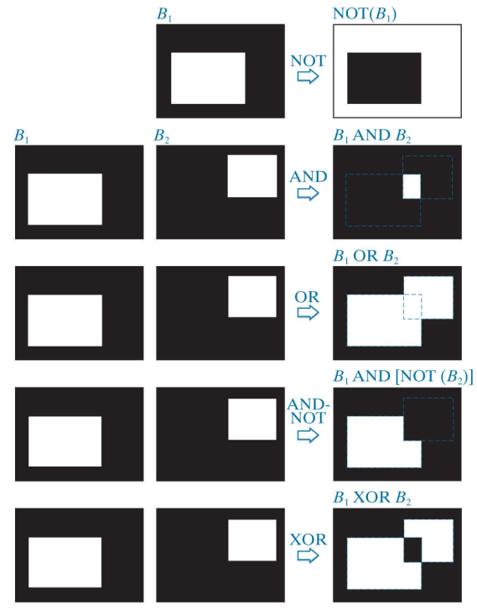
Logical Operations
Notes:
Help Link: http://users.wfu.edu/matthews/misc/DigPhotog/alias/

Slide 32
Spatial Operations
Spatial operations are performed directly on the pixels of a given image.
Classifications of spatial operations:
Single pixel operations
Neighborhood operations
Geometric spatial transformations
Notes:
Help Link: http://users.wfu.edu/matthews/misc/DigPhotog/alias/

Slide 33
Spatial Operations
Single Pixel Operations
Alter the values of an image pixels based on intensity.
Finding the negative of a given image.
Example: NOT operation.
0 | 0 | 0 | 0
0 | 1 | 1 | 0
0 | 1 | 1 | 0
0 | 1 | 1 | 0
0 | 0 | 0 | 0
1 | 1 | 1 | 1
1 | 0 | 0 | 1
1 | 0 | 0 | 1
1 | 0 | 0 | 1
1 | 1 | 1 | 1
Notes:
Help Link: http://users.wfu.edu/matthews/misc/DigPhotog/alias/

Slide 34
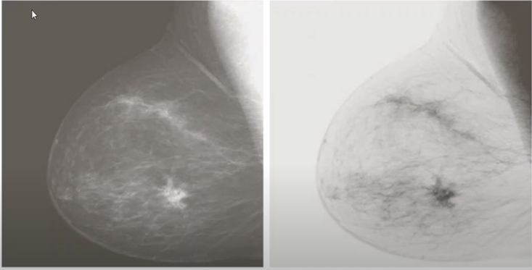
Spatial Operations
Single Pixel Operations
Figure 6: Image Negatives
Notes:
Help Link: http://users.wfu.edu/matthews/misc/DigPhotog/alias/

Slide 35
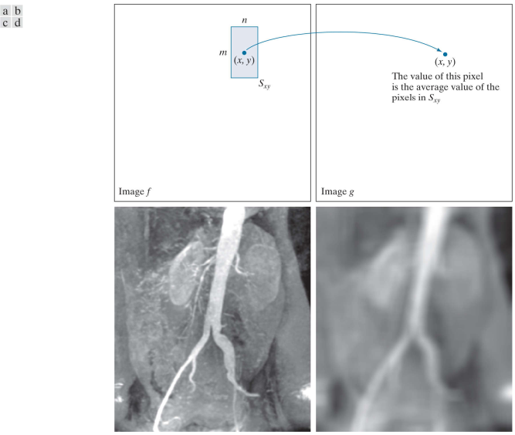
Spatial Operations
Neighborhood Operations
- The net effect is to perform local blurring in the original image.
Figure 6: Local averaging using neighborhood processing. The procedure is illustrated in (a) and (b) for a rectangular neighborhood. (c) An aortic angiogram (d) The result of using neighborhood operations.
Notes:
Help Link: http://users.wfu.edu/matthews/misc/DigPhotog/alias/

Slide 36
Spatial Operations
Neighborhood operations
At first we need to select the center pixel and find it’s 3x3 neighbors and calculate the average of all neighbor pixels and update the center pixel.
7 | 5 | 2 | 7 | 2 | 1 | 5
1 | 5 | 2 | 9 | 2 | 8 | 8
7 | 4 | 1 | 8 | 1 | 4 | 5
6 | 4 | 2 | 7 | 2 | 2 | 5
6 | 5 | 2 | 4 | 2 | 1 | 5
5 | 5 | 2 | 5 | 2 | 8 | 4
5 | 4 | 2 | 2 | 2 | 5 | 5
5 | 4 | 3 | 4 | 3 | 6 | 2
Notes:
Help Link: http://users.wfu.edu/matthews/misc/DigPhotog/alias/

Slide 37
Spatial Operations
Neighborhood operations
At first we need to select the border pixel as the center pixel and to find it’s 3x3 neighbors, zero padding is needed and calculate the average of all neighbor pixels and update the center pixel.
0 | 0 | 0 | 0 | 0 | 0 | 0 | 0 | 0
0 | 7 | 5 | 2 | 7 | 2 | 1 | 5 | 0
0 | 1 | 5 | 2 | 9 | 2 | 8 | 8 | 0
0 | 7 | 4 | 1 | 8 | 1 | 4 | 5 | 0
0 | 6 | 4 | 2 | 7 | 2 | 2 | 5 | 0
0 | 6 | 5 | 2 | 4 | 2 | 1 | 5 | 0
0 | 5 | 5 | 2 | 5 | 2 | 8 | 4 | 0
0 | 5 | 4 | 2 | 2 | 2 | 5 | 5 | 0
0 | 5 | 4 | 3 | 4 | 3 | 6 | 2 | 0
0 | 0 | 0 | 0 | 0 | 0 | 0 | 0 | 0
Notes:
Help Link: http://users.wfu.edu/matthews/misc/DigPhotog/alias/

Slide 38
Spatial Operations
Geometric spatial transformations
-Spatial transformation of an image is a geometric transformation of the image coordinate system.
Where,
(v, w) - pixel coordinates in the original image
(x, y) -The corresponding pixel coordinates in the transformed image
Notes:
Help Link: http://users.wfu.edu/matthews/misc/DigPhotog/alias/

Slide 39
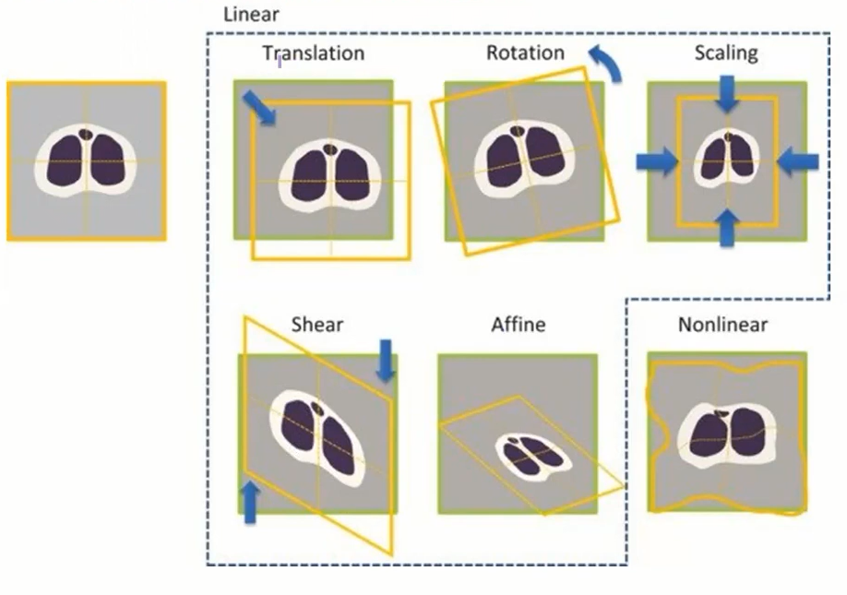
Spatial Operations
Geometric spatial transformations
Notes:
Help Link: http://users.wfu.edu/matthews/misc/DigPhotog/alias/

Slide 40
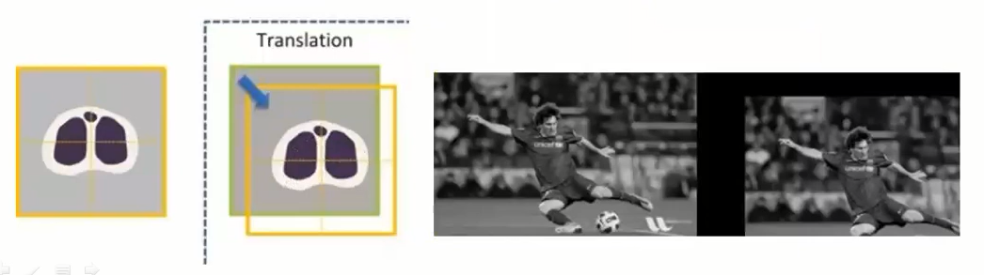
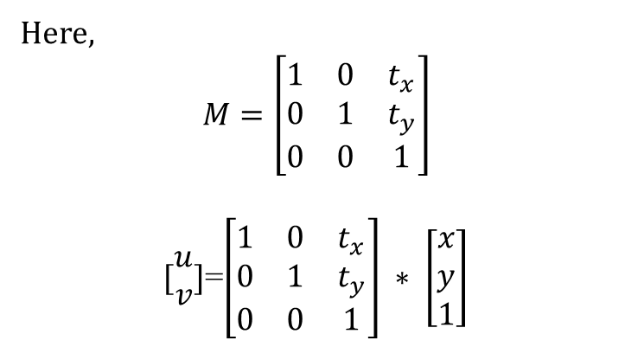
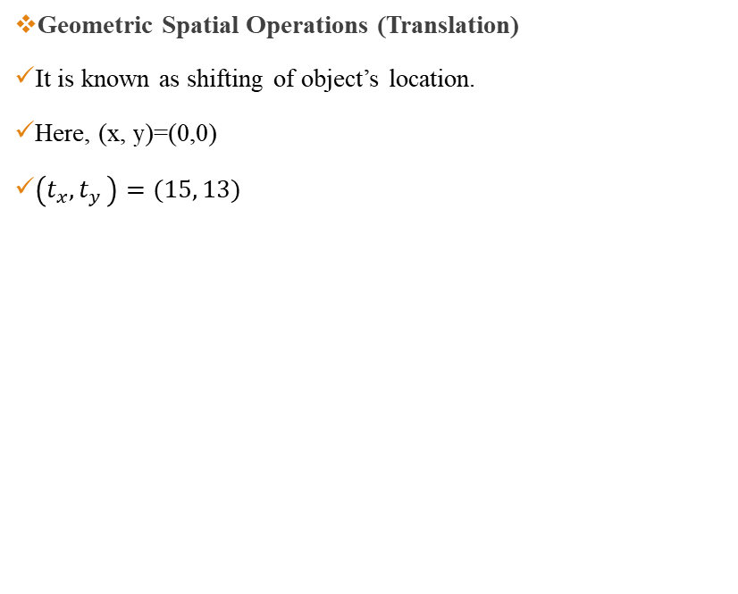
Spatial Operations
Geometric Spatial Operations (Translation)
It is known as shifting of object’s location.
Here, (x, y)=(0,0)
$\left(t_{x}{,t}_{y}\right)=(15, 13)$
Here, $$M=\left[\begin{matrix}1 & 0 & t_{x} \\ 0 & 1 & t_{y} \\ 0 & 0 & 1\end{matrix}\right]$$
$[\begin{matrix}u \\ v\end{matrix}]$=$\left[\begin{matrix}1 & 0 & t_{x} \\ 0 & 1 & t_{y} \\ 0 & 0 & 1\end{matrix}\right] ∗ \left[\begin{matrix}x \\ y \\ 1\end{matrix}\right]$
Notes:
Help Link: http://users.wfu.edu/matthews/misc/DigPhotog/alias/

Slide 41
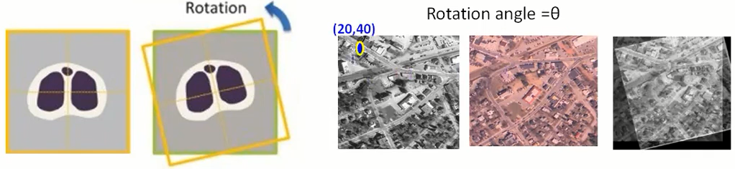
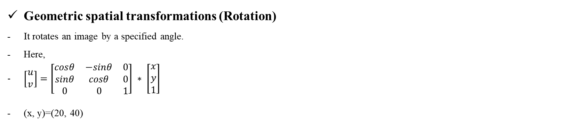
Spatial Operations
Geometric spatial transformations (Rotation)
It rotates an image by a specified angle.
Here,
$\left[\begin{matrix}u \\ v\end{matrix}\right]=\left[\begin{matrix}cosθ & −sinθ & 0 \\ sinθ & cosθ & 0 \\ 0 & 0 & 1\end{matrix}\right] ∗ \left[\begin{matrix}x \\ y \\ 1\end{matrix}\right]$
(x, y)=(20, 40)
Notes:
Help Link: http://users.wfu.edu/matthews/misc/DigPhotog/alias/

Slide 42
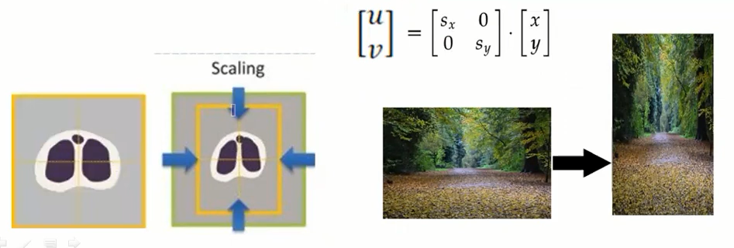
Spatial Operations
Geometric spatial transformations (Scaling)
Scaling means resize of an image in terms of scaling factor.
If we have an image of (300 X 400) and we want to transform it into a shape of (600 X 200).
The scaling in X and Y direction will be 600/300=2 and 200/400 =1/2
Notes:
Help Link: http://users.wfu.edu/matthews/misc/DigPhotog/alias/

Slide 43
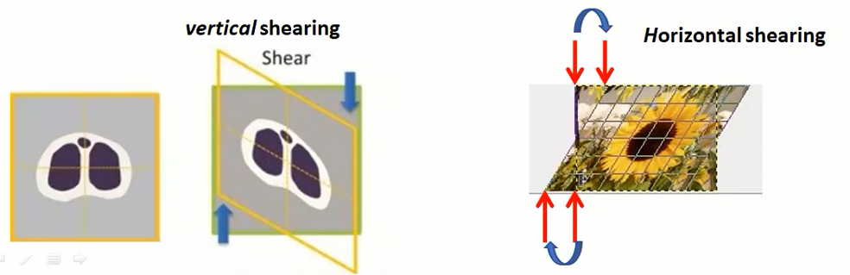
Spatial Operations
Geometric spatial transformations (Shearing)
Shearing an image means shifting the pixel values either horizontally or vertically.
Basically, this shifts some part of an image to one direction and other parts to the another direction. Horizontal shearing will shift the upper part to the right and lower part to the left. Vertical shearing will shift left part to upper and right part to lower.
Notes:
Help Link: http://users.wfu.edu/matthews/misc/DigPhotog/alias/

Slide 44
Spatial Operations
Geometric spatial transformations and image registration
Image registration is the process of transforming different sets of data into one co-ordinate system.
Image registration is an important application of digital image processing used to align two or more images of the same scene. In image registration, we have available an input image and a reference image. The objective is to transform the input image geometrically to produce an output image that is aligned (registered) with the reference image.
Application: Fusion of medical images, like SPECT-MRI, CT-MRI etc.
Notes:
Help Link: http://users.wfu.edu/matthews/misc/DigPhotog/alias/

Slide 45
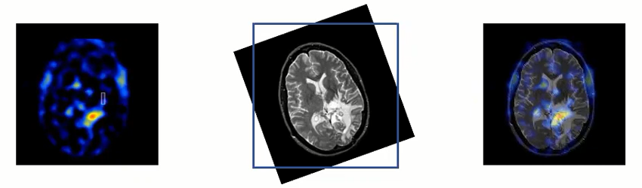
Spatial Operations
Geometric spatial transformations and image registration
In many applications, it is necessary to combine multiple images of the same scene acquired by different sensors or same sensors, from same or different viewpoint.
Following the figures indicate SPECT (Single-Photon Emission Computerized Tomography) and MRI images of brain.
Notes:
Help Link: http://users.wfu.edu/matthews/misc/DigPhotog/alias/

Slide 46
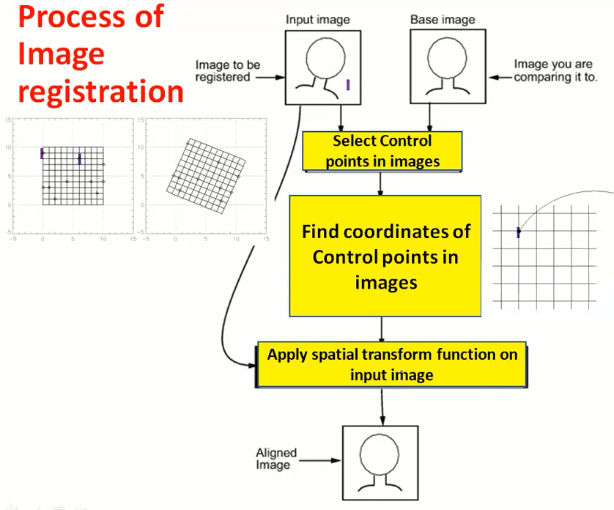
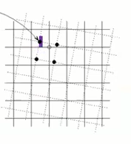
Spatial Operations
Notes:
Help Link: http://users.wfu.edu/matthews/misc/DigPhotog/alias/

Slide 47
Thank You ☺

